Slide 1
DESIGN PHASE

Slide 2
Introduction
design phase of the SDLC uses the requirements that were gathered during analysis to create a blueprint for the future system
A successful design builds on what was learned in earlier phases and leads to a smooth implementation by creating a clear, accurate plan of what needs to be done.

Slide 3
Transition From Requirements to Design
The purpose of the design phase is to decide how to build it.
System design is the determination of the overall system architecture—consisting of
a set of physical processing components,
hardware,
software,
people, and
the communication among them that will satisfy the system’s essential requirements.

Slide 4
System Blueprint
During the initial part of design, the project team converts the business requirements for the system into system requirements that describe the technical details for building the system.
system requirements are communicated through a collection of design documents and physical process and data models.
Together, the design documents and physical models make up the blueprint for the new system.

Slide 5
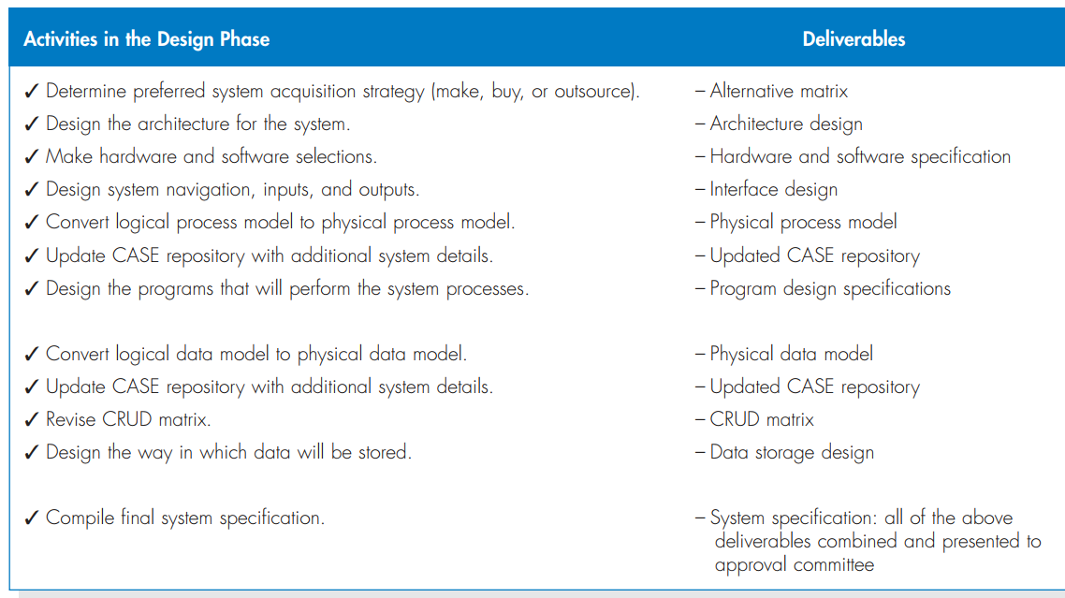
System Blueprint
The design phase has a number of activities that lead to the system blueprint

Slide 6
System specification
At the end of the design phase, the project team creates the final deliverable for the phase called the system specification.
Collectively, the system specification conveys exactly what system the project team will implement during the implementation phase of the SDLC

Slide 7
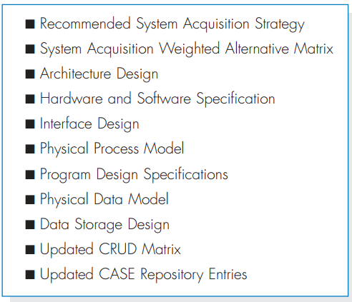
System specification

Slide 8
System Acquisition Strategies
Until now, we have implicitly assumed that the system will be designed, developed, and implemented by the project team.
This is not an entirely realistic assumption
team may recognize that some parts or even all of the new system’s software will be acquired from some outside provider.
Some organizations have established acquisition policies strongly favoring purchased software.

Slide 9
System Acquisition Strategies
Does this mean that all of the work
It is essential to know what we need before seeking a product that provides the best fit.
There are three primary ways to approach the creation of a new system:
(1) develop a custom application in-house;
(2) buy a packaged system and (possibly) customize it; and
(3) rely on an external vendor, developer, or service provider to build or provide the system.

Slide 10
Custom Development
the best way to create a system !!!
In many cases, it could be very effective to create a new system from scratch that meets highly specialized requirements.
In some situations, the challenges being addressed with the new system are so significant and demanding that serious systems engineering is required to solve them.
In these cases, the developers really cannot find a packaged solution that is capable of meeting the project requirements, and a custom development project is the only real viable choice

Slide 11
Custom Development
Custom development also allows developers to be flexible and creative in the way they solve business problems.
Building a system in-house also builds technical skills and functional knowledge within the company.
As developers work with business users, their understanding of the business grows and they become better able to align information systems with strategies and needs

Slide 12
Custom Development
However, requires a dedicated effort that includes long hours and hard work.
Many companies have a development staff that is already overcommitted.
Facing huge backlogs of systems requests, the staff just does not have time for another project.
Also, a variety of skills—technical, interpersonal, functional, project management, modeling—all have to be in place for the project to move ahead smoothly.
IS professionals, especially highly skilled individuals, are quite difficult to hire and retain.

Slide 13
Custom Development
The risks associated with building a system from the ground up can be quite high, and there is no guarantee that the project will succeed
Developers could be pulled away to work on other projects, technical obstacles could cause unexpected delays, and the business users could become impatient with a growing timeline.

Slide 14
Packaged Software
Many business needs are not unique, and because it makes little sense to reinvent the wheel, many organizations buy packaged software that has already been written, rather than developing their own custom solution
It can be much more efficient to buy programs that have already been created, tested, and proven, and a packaged system can be bought and installed quickly compared with a custom system
packaged systems must accept the functionality that is provided by the system, and rarely is there a perfect fit.

Slide 15
Workaround
Most packaged applications allow for some customization or for the manipulation of system parameters to change the way certain features work.
If the amount of customization is not enough and the software package has a few features that don’t quite work the way the company needs them to work, the project team can create a workaround.
A workaround is a custom-built add-on program that interfaces with the packaged application to handle special needs. It can be a nice way to create needed functionality that does not exist in the software package.

Slide 16
Systems integration
refers to the process of building new systems by combining packaged software, existing legacy systems, and new software written to integrate these.
it is not uncommon for companies to select the packaged software option and then outsource the integration of a variety of packages to a consulting firm

Slide 17
Outsourcing
means hiring an external vendor, developer or service provider to create or supply the system
Outsourcing firms called application service providers (ASPs) supply software applications and/or software-related services over wide area networks or the Internet.
In this approach to obtaining software, the ASP hosts and manages a software application, and owns, operates, and maintains the servers that run the application.
The ASP also employs the people needed to maintain the application.

Slide 18
Outsourcing
There is an array of application service providers.
Some deliver high-end business applications that can serve the entire enterprise.
Some are focused more on serving a small- to medium-sized business clientele.
Some ASPs specialize in specific business needs (such as CRM, for example),
Some specialize in specific industries (e.g., healthcare).
There is a low cost of entry and, an extremely short setup time.
The pay-as-you-go model is often significantly less
Investments in IT staff can be reduced, and investments in specialized IT infrastructure often can be avoided.

Slide 19
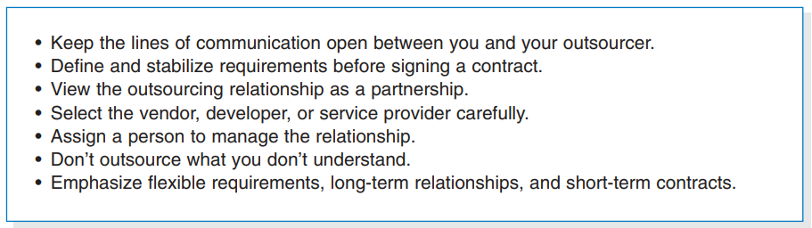
Outsourcing
Outsourcing firms are also available that will develop a custom system on behalf of the customer. There can be great benefit to having others develop your system.
-ve. compromise confidential information or lose control over future development.

Slide 20
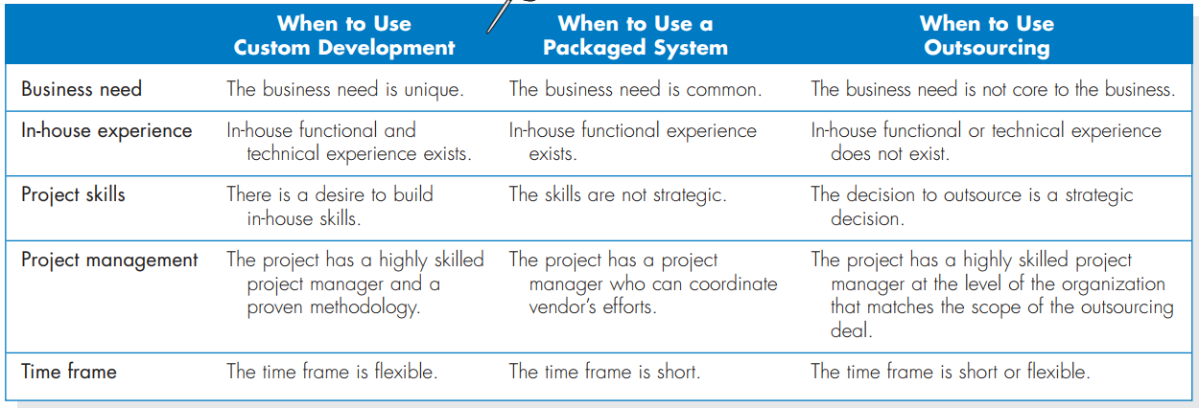
Influences On The Acquisition Strategy
no one strategy is inherently better than the others
it is important to understand the strengths and weaknesses of each strategy and when to use each

